Slide 1



Hardware and Software Fundamentals of Intelligent Computing Systems

Slide 2
Lecture 41: KernelGen Architecture and Prompt Engineering

Slide 3
目录
KernelGen background
KernelGen workflow
Prompt engineering
KernelGen usage example

Slide 4
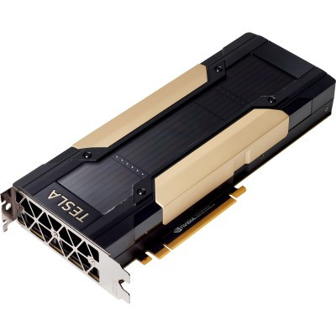



KernelGen background
KernelGen core objectives
Utilizing AI technology to automatically generate GPU kernel code, achieving ultimate performance optimization for target hardware and resolving the challenges of manual programming.
The industry faces challenges
The GPU programming model is complex, with large differences between architectures, lacking general optimization strategies, and having extremely high thresholds for parallel computing scheduling and memory management.
Core value of the project
Significantly lowering the threshold for GPU application development, unleashing the potential of hardware computing power, and improving the execution efficiency of computing tasks as well as resource utilization.

Slide 5
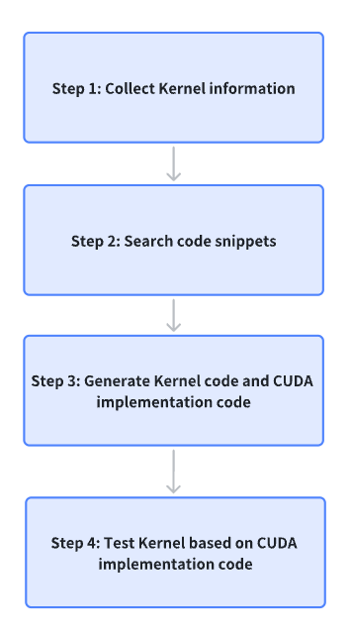
KernelGen workflow
Collect kernel information
The user inputs the operator definition semantics to KernelGen.
Search code snippets
KernelGen searches for code snippets similar to user-defined ones as referencesKernelGen.
Generate kernel code and CUDA version benchmark implementation code
KernelGen generates Kernel code and CUDA-based benchmark implementation code.
Based on the CUDA version of the benchmark implementation code, test the Kernel
KernelGen benchmarks kernels based on PyTorch and outputs test results for correctness and speedup ratios.

Slide 6
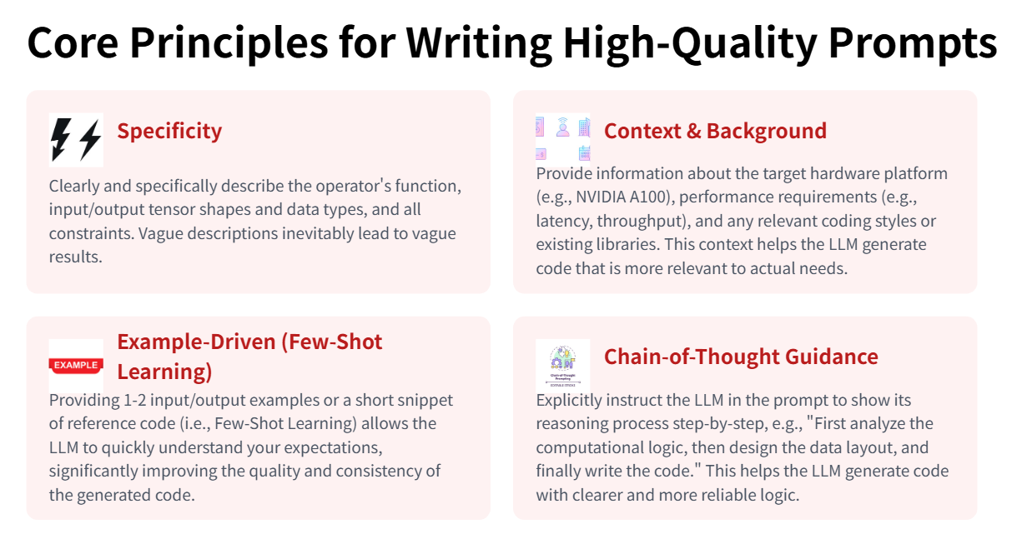
Prompt engineering
Notes:
单击此处添加文本

Slide 7
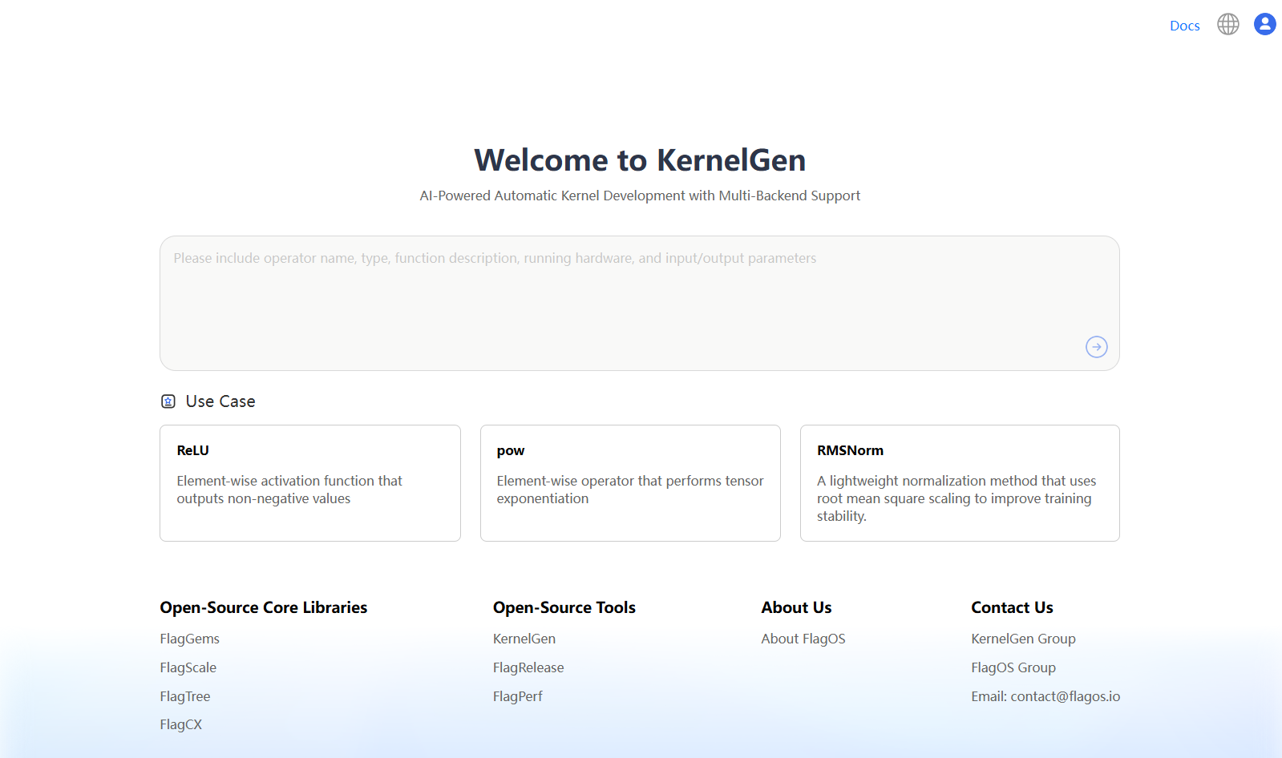
KernelGen usage example
Generate a ReLU Kernel using KernelGen：https://kernelgen.flagos.io/home

Slide 8
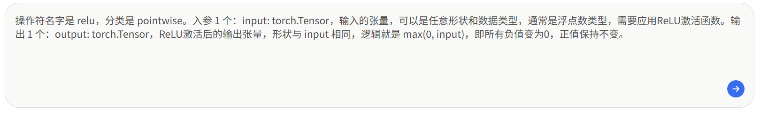
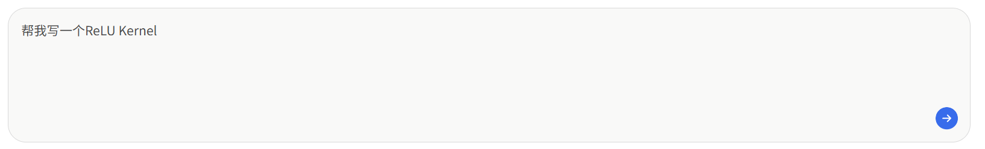
KernelGen usage example
Clear, high-quality prompt：
Vague, low-quality prompt：

Slide 9
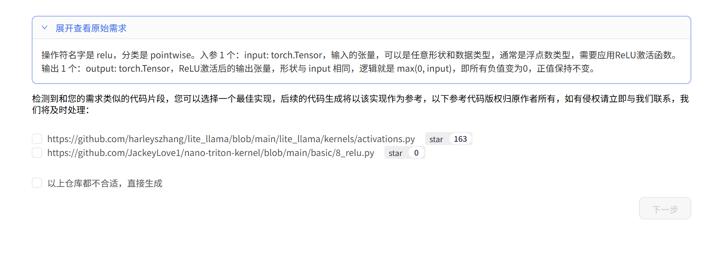
KernelGen usage example
Select the appropriate reference code and click next.

Slide 10
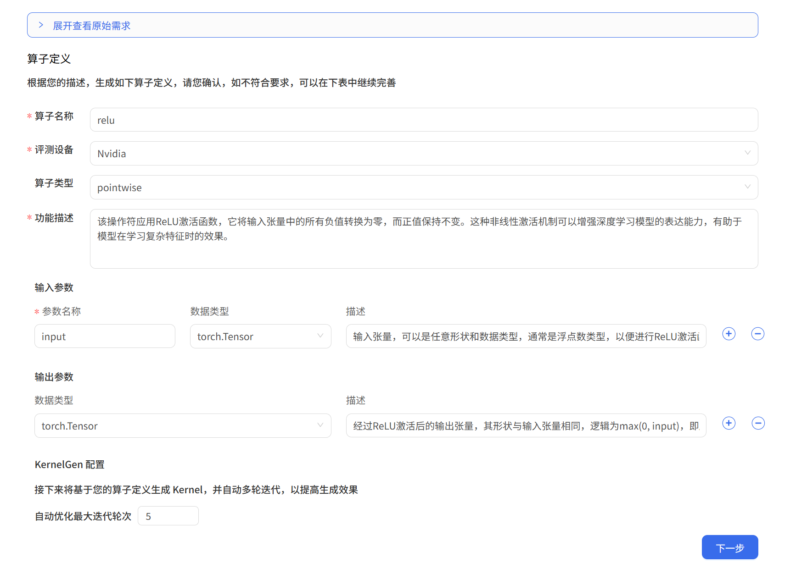
KernelGen usage example
Fill in the operator details to further enhance the prompt:
The operator name must be in English.
The evaluation equipment currently supports NVIDIA, Tianshu, Hygon, Huawei, and Moore Threads.
A higher number of iterations typically results in better-generated operators, with a single iteration of a simple operator usually taking 2~3 minutes.

Slide 11
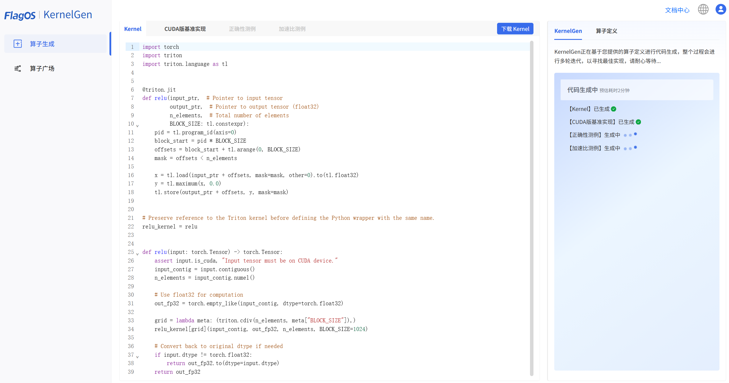
KernelGen usage example
Start generating kernel, CUDA implementation, correctness test cases, and speedup test cases:

Slide 12
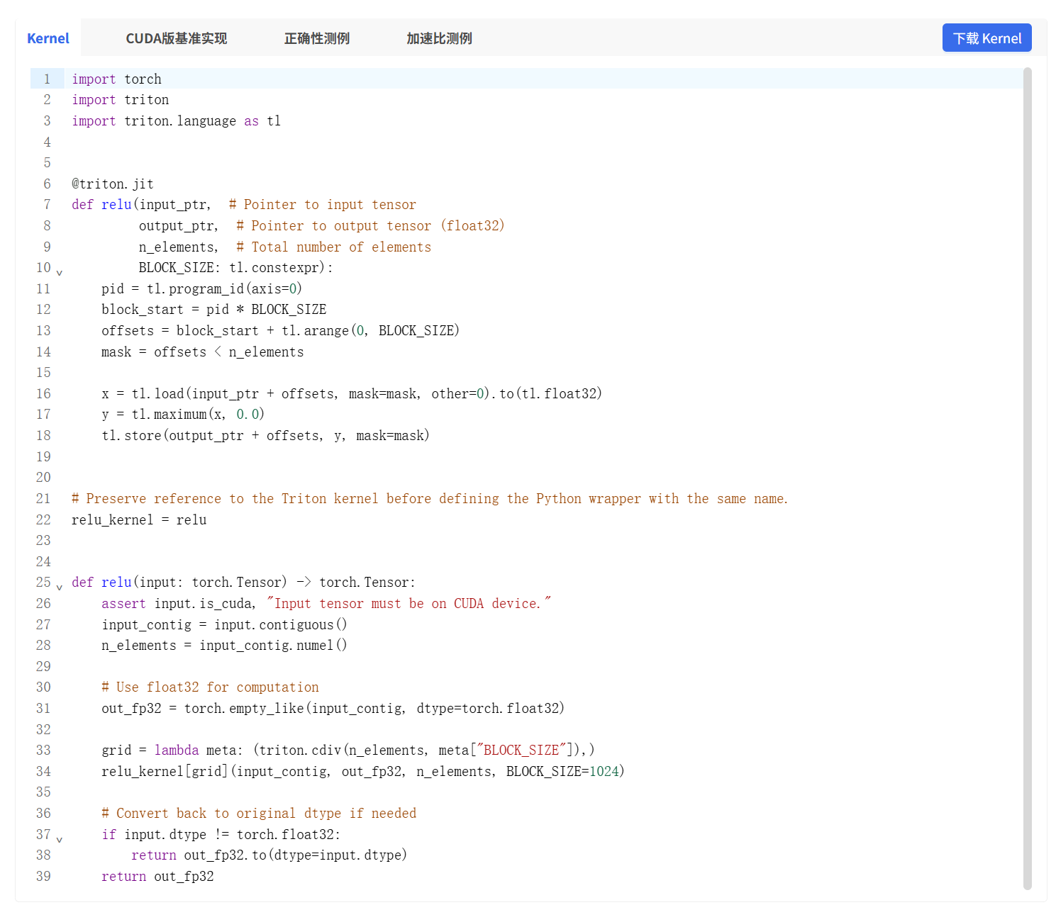
KernelGen usage example
kernel：

Slide 13
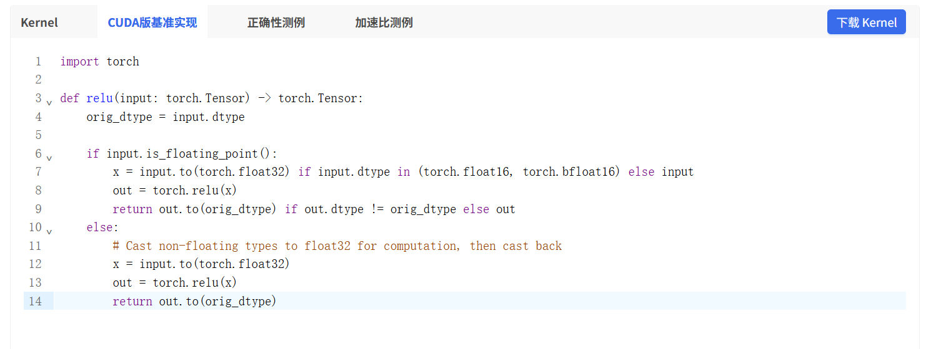
KernelGen usage example
CUDA：

Slide 14
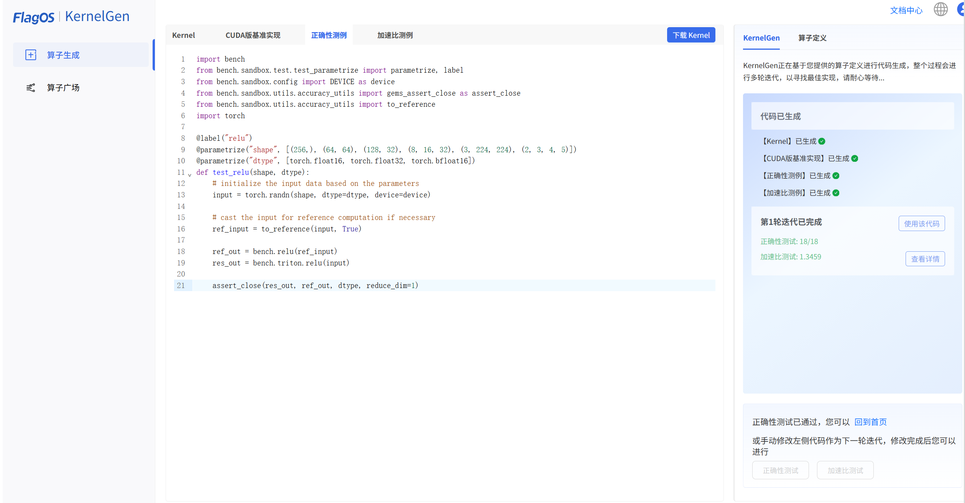
KernelGen usage example
correctness test cases：

Slide 15
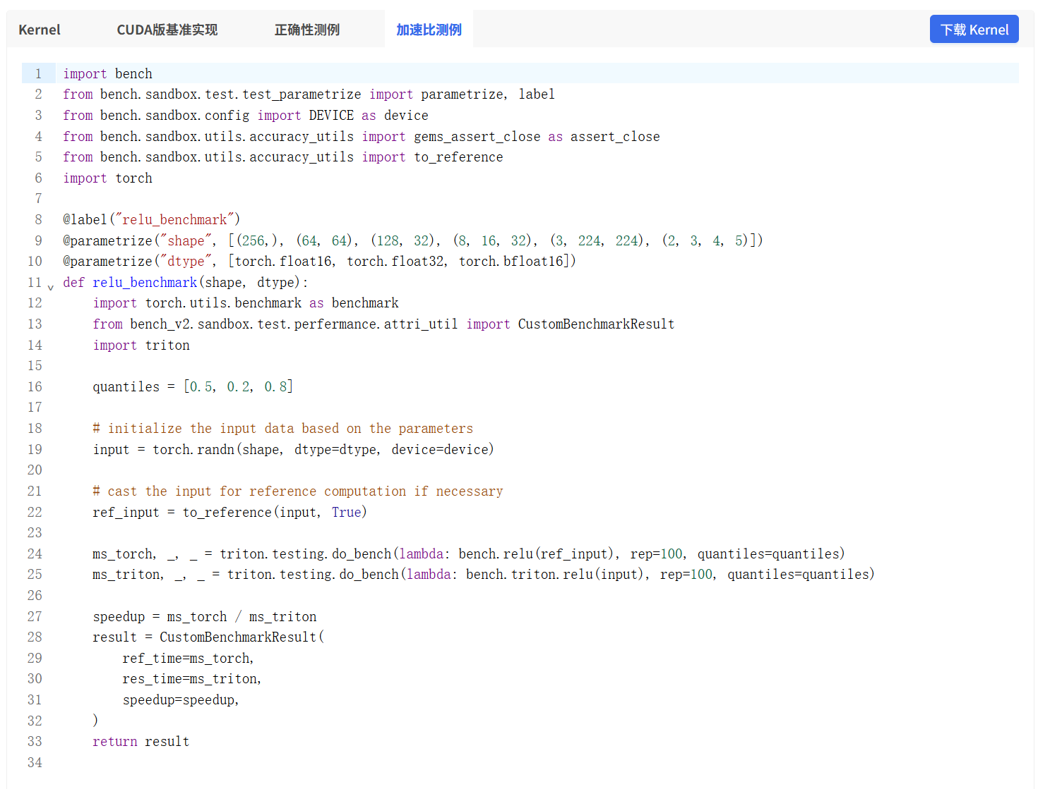
KernelGen usage example
speedup test cases：

Slide 16
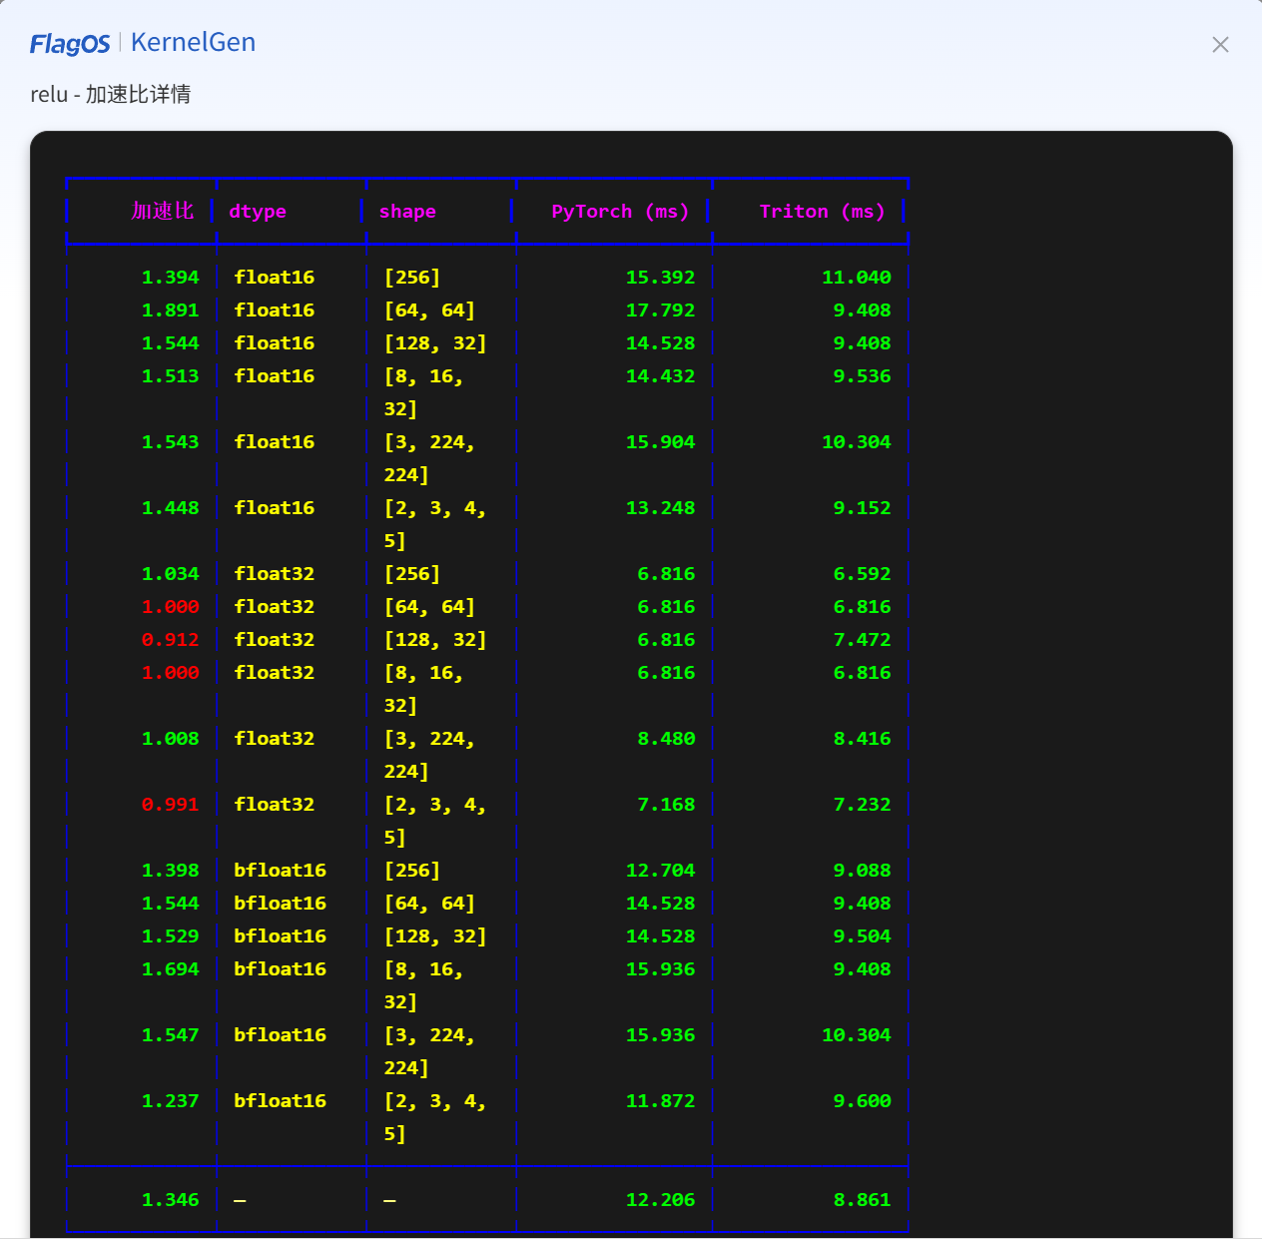
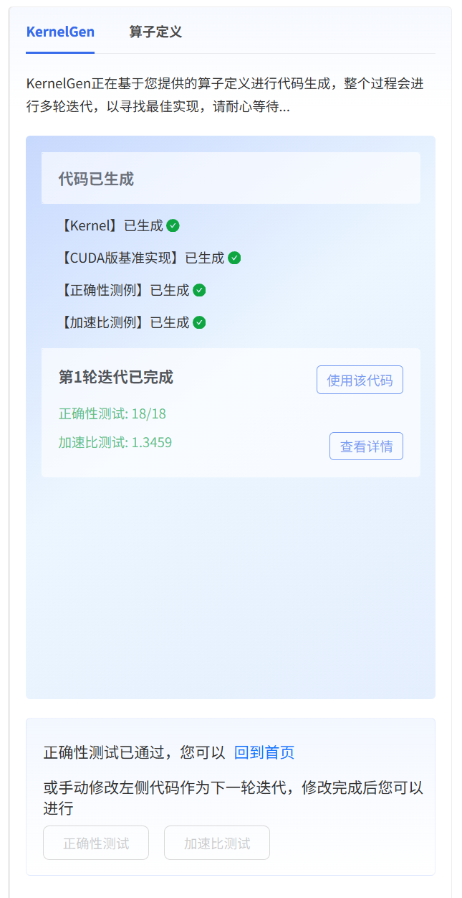
KernelGen usage example
After each iteration, you may choose to use the existing code or manually modify and test it again.
The specific time consumption of the kernel and corresponding CUDA implementation across various test cases

Slide 17
Tips
Currently, KernelGen only supports single-round prompts, with a new version to be released later that will enable multi-round prompt iterations for specific test cases;
Integration with the FlagOS ecosystem: Specialized tools on GitHub are available to convert KernelGen-generated code into FlagGems format;
KernelGen officially plans to integrate KernelGen into IDEs such as vscode by the end of March, further simplifying kernel development.

Slide 18

The Solution: FlagOS, a Unified AI Software Stack

Slide 19








https://space.bilibili.com/3546791834290849
https://github.com/flagos-ai
https://www.zhihu.com/people/95-22-20-18/posts
https://flagos.io/Home

Slide 20

Thanks for your time！

